Slide 1
Context-Free Languages

Slide 2




Context-Free Languages
Regular Languages

Slide 3
Context-Free Languages
Context-Free
Grammars
Pushdown
Automata
stack
automaton

Slide 4
Context-Free Grammars

Slide 5

Grammars
Grammars express languages
Example: the English language grammar

Slide 6
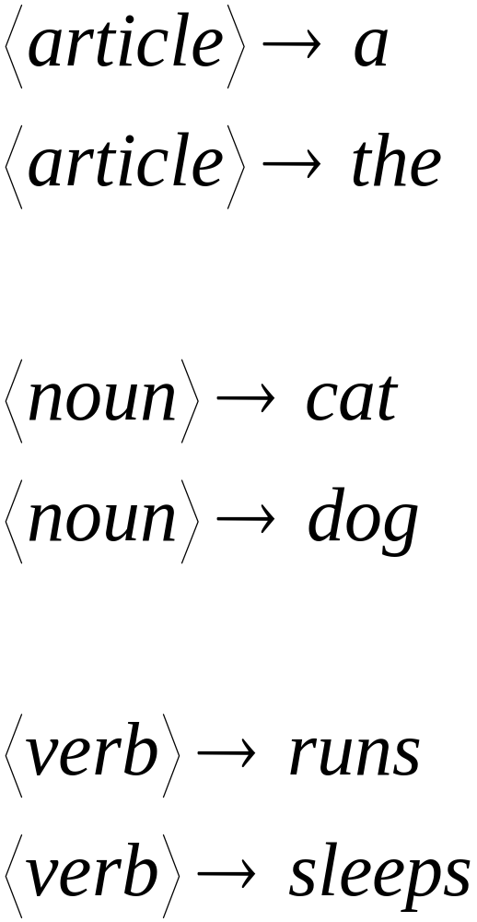

Slide 7
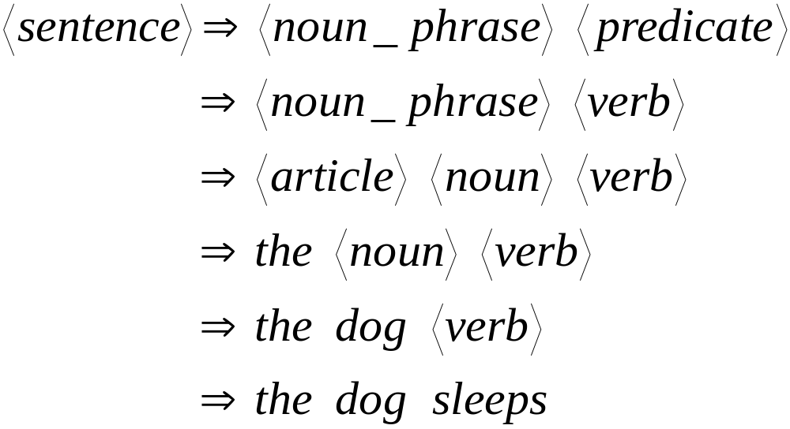
Derivation of string “the dog walks”:

Slide 8
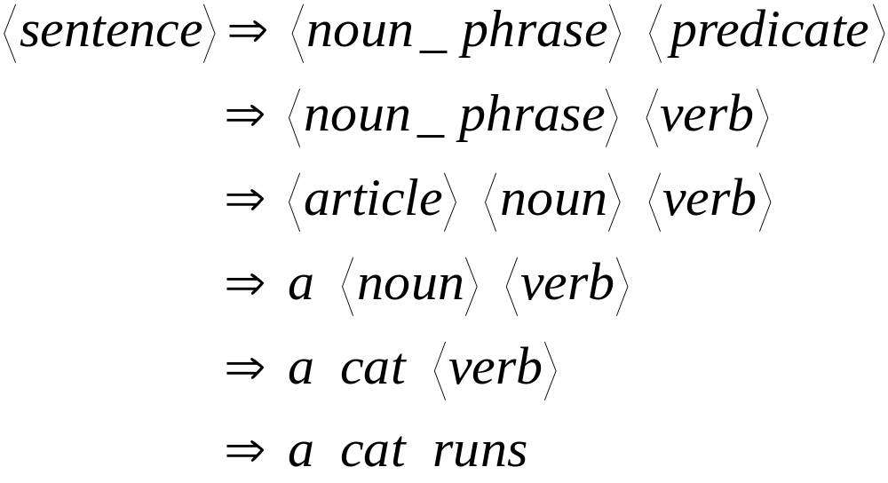
Derivation of string “a cat runs”:

Slide 9
Language of the grammar:
L = { “a cat runs”,
“a cat sleeps”,
“the cat runs”,
“the cat sleeps”,
“a dog runs”,
“a dog sleeps”,
“the dog runs”,
“the dog sleeps” }

Slide 10
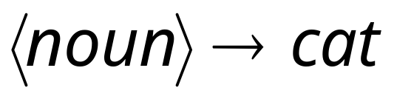
Productions
Sequence of
Terminals (symbols)
Variables
Sequence of Variables

Slide 11


Another Example
Sequence of
terminals and variables
Grammar:
Variable
The right side
may be

Slide 12




Grammar:
Derivation of string :

Slide 13



Grammar:
Derivation of string :

Slide 14

Grammar:
Other derivations:

Slide 15

Grammar:
Language of the grammar:

Slide 16

A Convenient Notation
We write:
Instead of:
for zero or more derivation steps

Slide 17

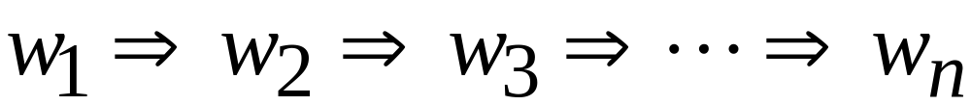
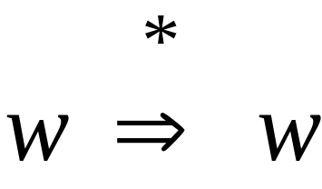
In general we write:
If:
in zero or more derivation steps
Trivially:

Slide 18
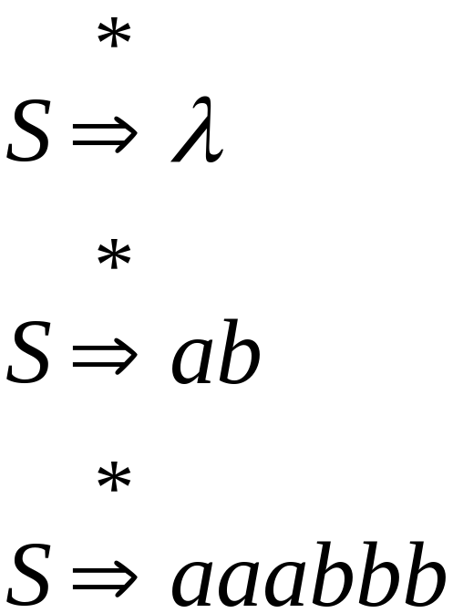
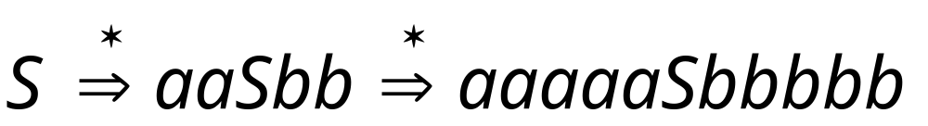
Example Grammar
Possible Derivations

Slide 19
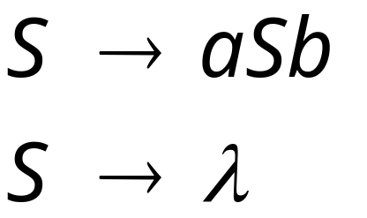
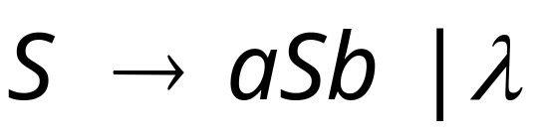
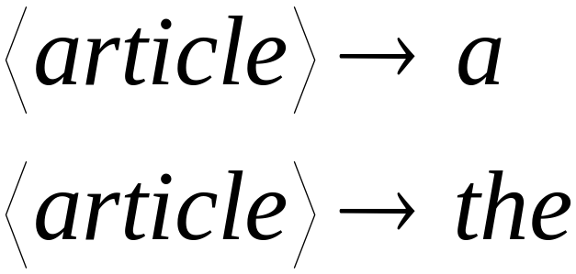
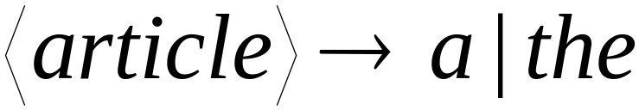
Another convenient notation:

Slide 20

Formal Definitions
Grammar:
Set of
variables
Set of
terminal
symbols
Start
variable
Set of
productions

Slide 21


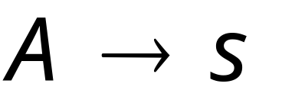
Context-Free Grammar:
All productions in are of the form
Variable
String of
variables and
terminals

Slide 22




Example of Context-Free Grammar
productions
start variable
variables
terminals

Slide 23




Language of a Grammar:
For a grammar with start variable
String of terminals or

Slide 24
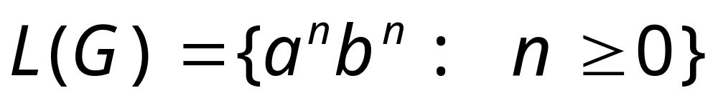
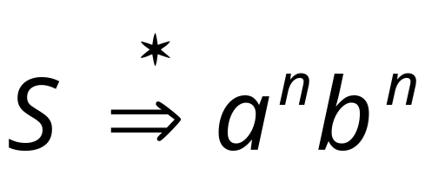
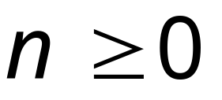
Example:
context-free grammar :
Since, there is derivation
for any

Slide 25

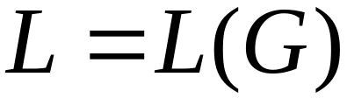
Context-Free Language:
A language is context-free
if there is a context-free grammar
with

Slide 26
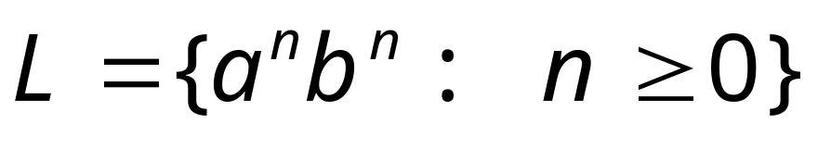
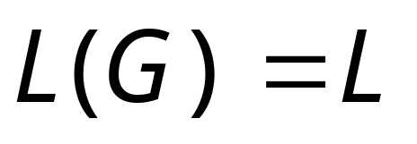
Example:
is a context-free language
since context-free grammar :
generates

Slide 27
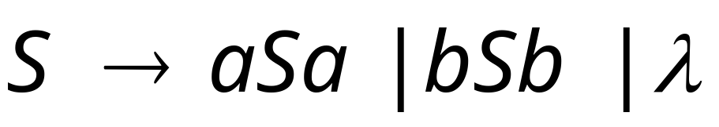


Another Example
Context-free grammar :
Example derivations:
Palindromes of even length

Slide 28
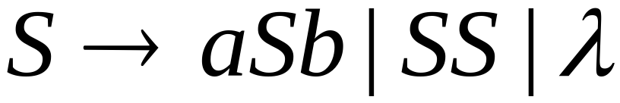
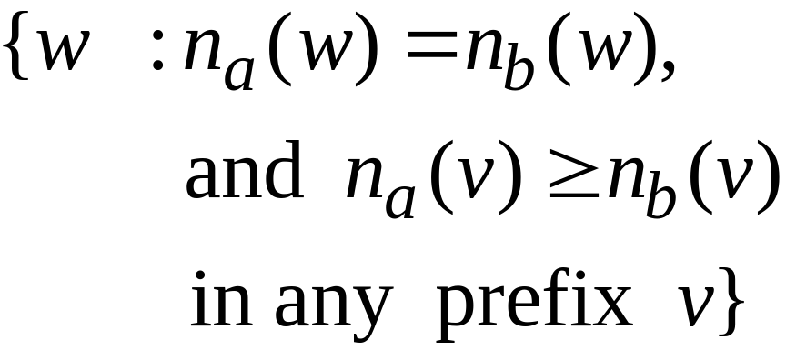

Another Example
Context-free grammar :
Example derivations:
Describes
matched
parentheses:
() ((( ))) (( ))

Slide 29
Derivation Order and
Derivation Trees

Slide 30
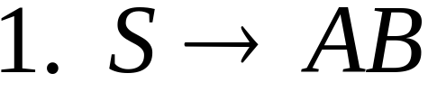
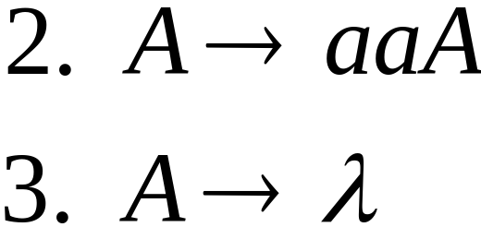
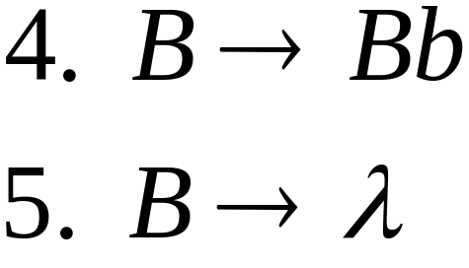
Derivation Order
Consider the following example grammar
with 5 productions:

Slide 31
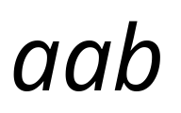

Leftmost derivation order of string :
At each step, we substitute the
leftmost variable

Slide 32

Rightmost derivation order of string :
At each step, we substitute the
rightmost variable

Slide 33
Leftmost derivation of :
Rightmost derivation of :

Slide 34

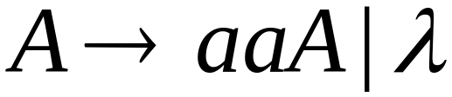
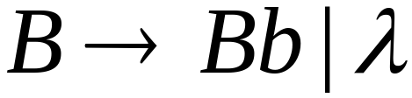
Derivation Trees
Consider the same example grammar:
And a derivation of :

Slide 35




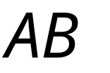
yield

Slide 36

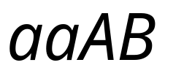

yield

Slide 37

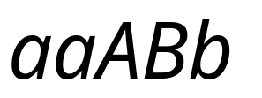
yield

Slide 38

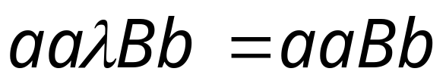
yield

Slide 39
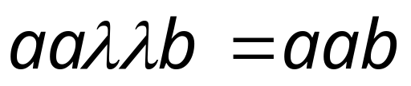
Derivation Tree
(parse tree)
yield

Slide 40
Sometimes, derivation order doesn’t matter
Leftmost derivation:
Rightmost derivation:
Give same
derivation tree

Slide 41
Ambiguity

Slide 42
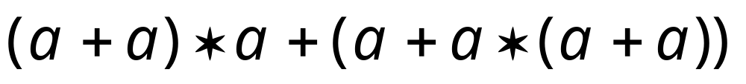
Grammar for mathematical expressions
Example strings:
Denotes any number

Slide 43





A leftmost derivation
for

Slide 44

Another
leftmost derivation
for

Slide 45
Two derivation trees
for

Slide 46

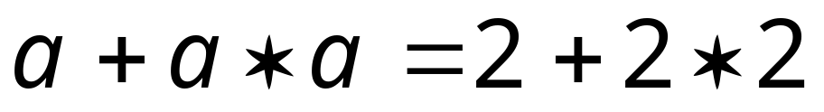

take

Slide 47





Good Tree
Bad Tree
Compute expression result
using the tree

Slide 48
Two different derivation trees
may cause problems in applications which
use the derivation trees:
Evaluating expressions
In general, in compilers
for programming languages

Slide 49

Ambiguous Grammar:
A context-free grammar is ambiguous
if there is a string which has:
two different derivation trees
or
two leftmost derivations
(Two different derivation trees give two
different leftmost derivations and vice-versa)

Slide 50
Example:
this grammar is ambiguous since
string
has two derivation trees

Slide 51
this grammar is ambiguous also because
string
has two leftmost derivations

Slide 52

Another ambiguous grammar:
IF_STMT
if EXPR then STMT
if EXPR then STMT else STMT
Variables
Terminals
Very common piece of grammar
in programming languages

Slide 53
If expr1 then if expr2 then stmt1 else stmt2
IF_STMT
if
expr1
then
STMT
if
expr2
then
stmt1
else
stmt2
Two derivation trees
IF_STMT
if
expr1
then
STMT
else
stmt2
if
expr2
then
stmt1

Slide 54
In general, ambiguity is bad
and we want to remove it
Sometimes it is possible to find
a non-ambiguous grammar for a language
But, in general we cannot do so

Slide 55
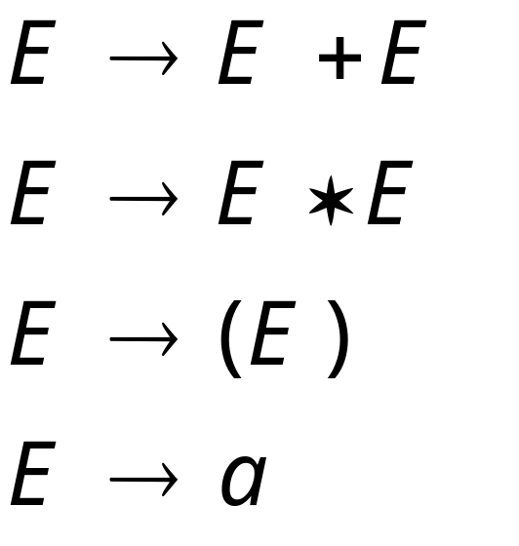
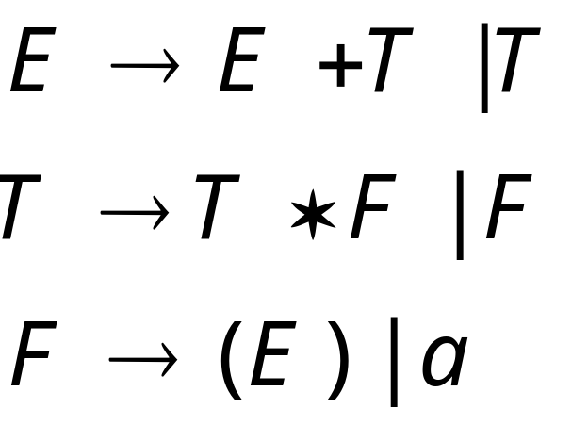
A successful example:
Equivalent
Ambiguous
Grammar
Non-Ambiguous
Grammar
generates the same
language

Slide 56

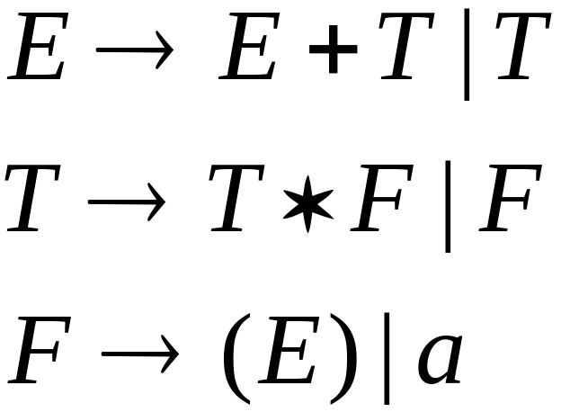


Unique
derivation tree
for

Slide 57
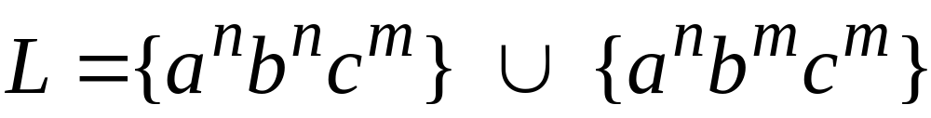


An un-successful example:
is inherently ambiguous:
every grammar that generates this
language is ambiguous

Slide 58


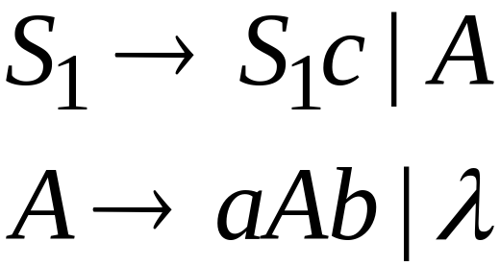
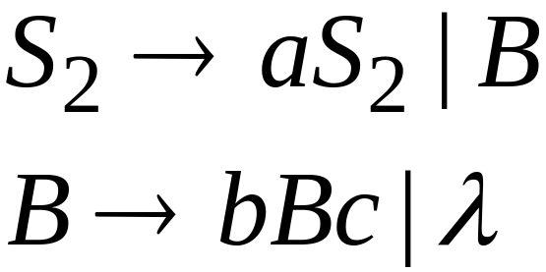
Example (ambiguous) grammar for :

Slide 59
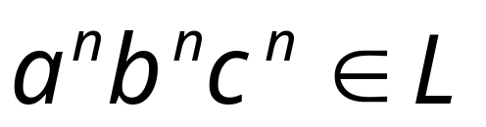



The string
has always two different derivation trees
(for any grammar)
For example

